Slide 1
Stable Machine Learning Knowledge Map Domain Analysis
Mohamed E. Fayad and Gaurav Kuppa m.fayad@aeehitg.com and gaurav.kuppa@sjsu.edu

Slide 2
Objectives
Establish stable machine learning knowledge through detailed domain analysis
Methodology to conduct domain analysis for core knowledge
An overview of machine learning knowledge map
Example architecture of a few patterns of the knowledge map represented

Slide 3
Motivations
Lack of Cohesion within Machine Learning
Do we have a unified paradigm for ML?
Domain Analysis Based on Tangibility
Is there a domain analysis done for ML?

Slide 4
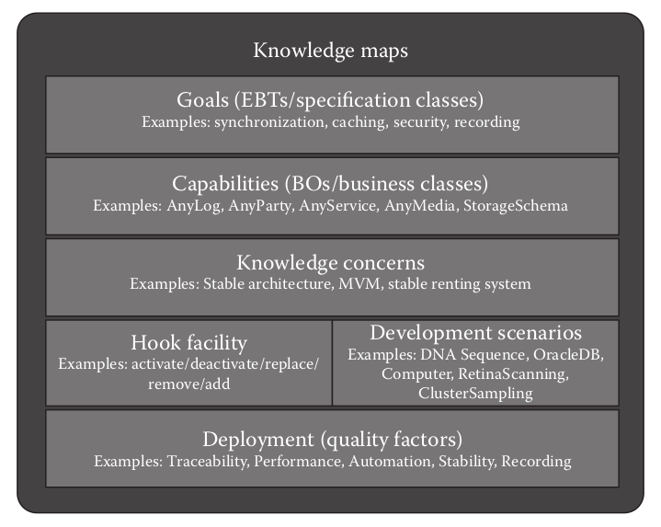
Knowledge Map Structure
A knowledge map
consists of a set of core knowledge sets and stable patterns that represents the functionality of any particular domain i.e. machine learning
this knowledge map will create a comprehensive understanding of the context and the domain of machine learning

Slide 5
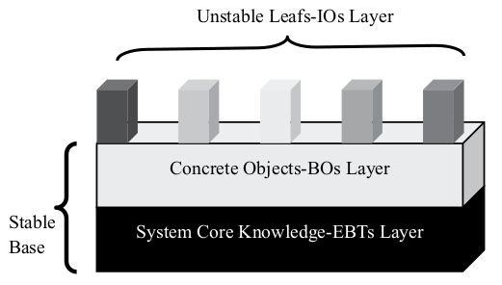
Knowledge Map Properties
Enduring Business Themes (EBTs)
Business Objects (BOs)
Industrial Objects (IOs)

Slide 6
EBTs
Embodies enduring, stable and core knowledge of the concept
Enduring Knowledge of Machine Learning
Intelligence
Automation
Computation
Understanding
And Many More...

Slide 7
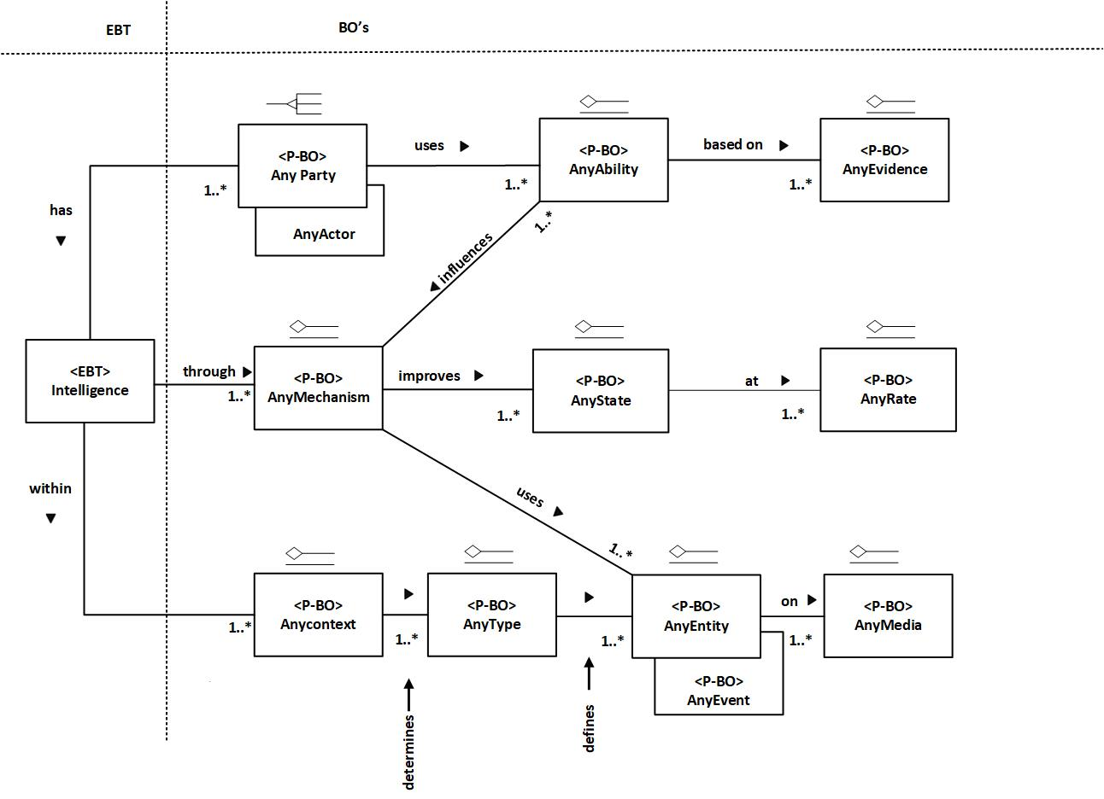
EBTs

Slide 8
BOs
Mapping from enduring knowledge to flexible objects
Stable extension of core knowledge to demonstrate capabilities of the system
Capabilities of Machine Learning
Model
Optimizer
Mechanism
And Many More...
Notes:
What do you think the goals of AnyMechanism is? These are the ultimate goals and quality factors of Mechanism (contain all the algorithms)

Slide 9
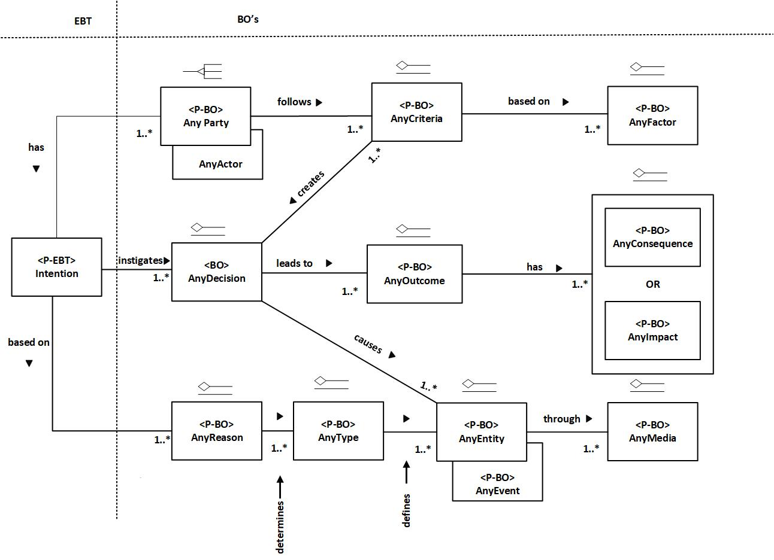
BOs

Slide 10
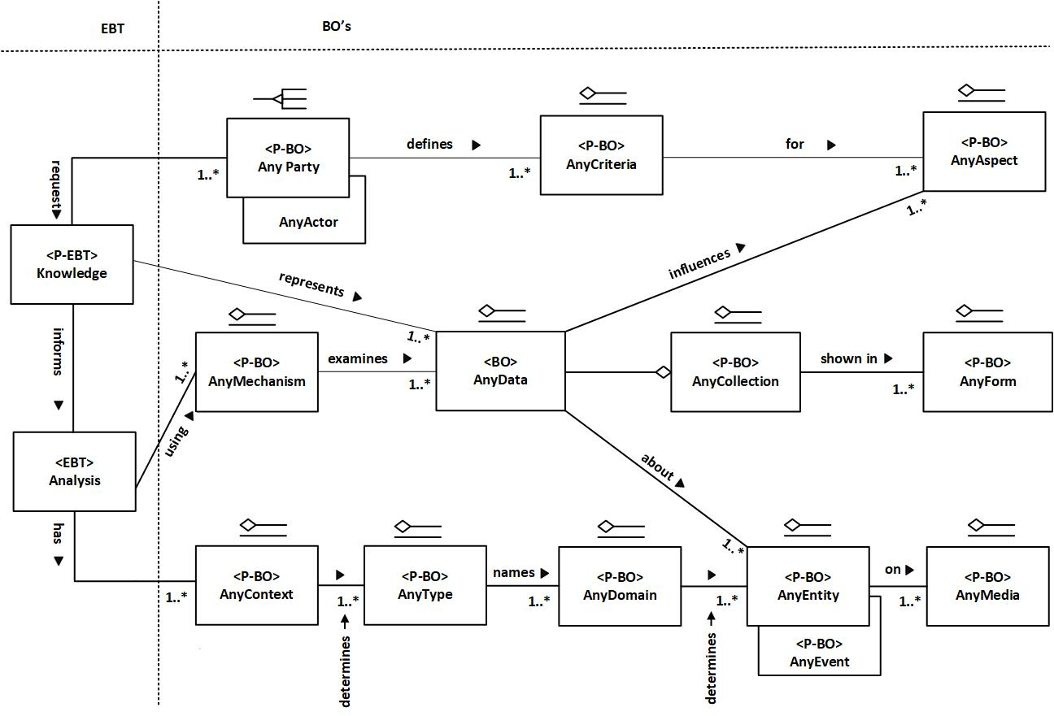
Architectural Patterns – Data Analysis

Slide 11
Non-functional Requirements
Each EBT and BO has a set of non-functional and functional requirements.
Positive, enduring, describe the system, assessment/metrics of system, branding.
Specifically, we will analyze the non-functional requirements of the following EBT, Intelligence.
Brightness
Understanding
Creativity
Learning
And Many More...

Slide 12
Conclusion
We have identified different EBTs and Business Objects (BOs) for machine learning and presented knowledge map for the same.
This speeds up application development time and increases stability.
Ultimate Design
Machine independent, does not reinvent the wheels
Applicable, extensible for benchmarking and comparisons
Build a stable standard
Top companies like Google, Facebook have internal standards
Machine learning has a dire need for a common, effective and stable standards

